Slide 1
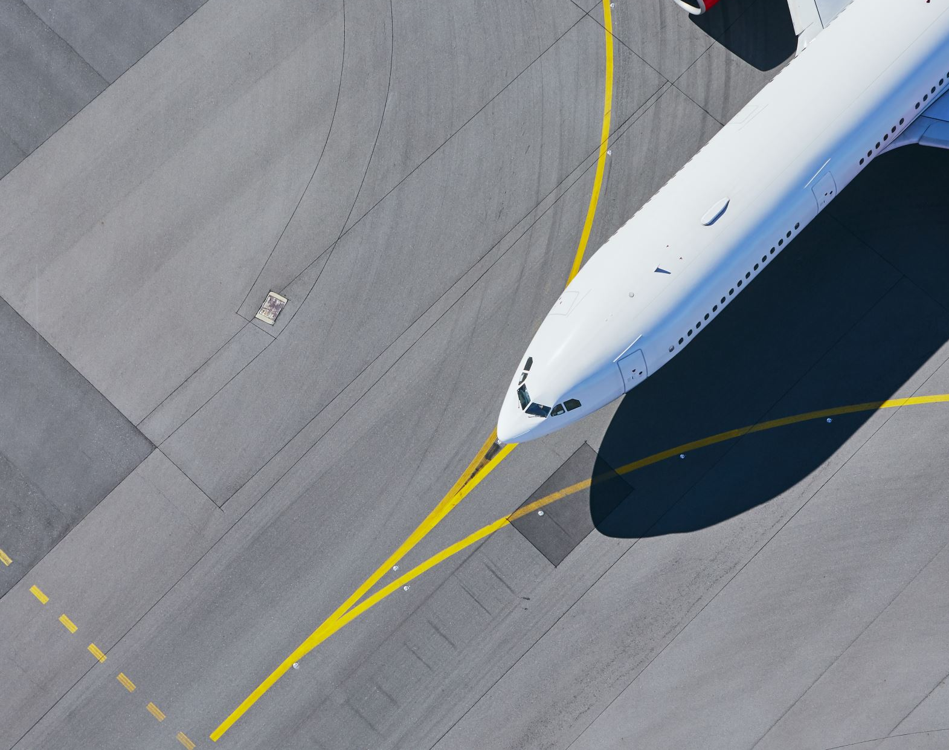
Sentiment Analysis of British Airways Reviews
Summary of Sentiment Analysis and Insights

Slide 2
Introduction
Good morning, everyone. My name is Olatunji Idris, and I'm a Big Data Analytics Student at the University of Derby. I'm pleased to share with you today the results from our sentiment analysis of reviews of British Airways.
Overview of Sentiment Analysis:
British Airways, as a prominent airline, receives a considerable amount of feedback from passengers. To gain insights into customer perceptions and satisfaction levels, we conducted a sentiment analysis on a dataset consisting of 1000 reviews.
Methodology Used:
For this analysis, we employed the VADER (Valence Aware Dictionary and sEntiment Reasoner) tool. VADER is a lexicon and rule-based sentiment analysis tool specifically tuned to social media texts. It scores each review based on the sentiment expressed in terms of positivity, negativity, and neutrality.
Purpose of the Analysis:
The main goal of this analysis is to understand the overall sentiment trends among British Airways customers. By identifying common themes and sentiments, we can pinpoint areas of strength and areas that require improvement.
Throughout the presentation, I'll be sharing key insights from our analysis, including sentiment distribution, common themes from positive and negative reviews, and recommendations for enhancing customer experience.

Slide 3
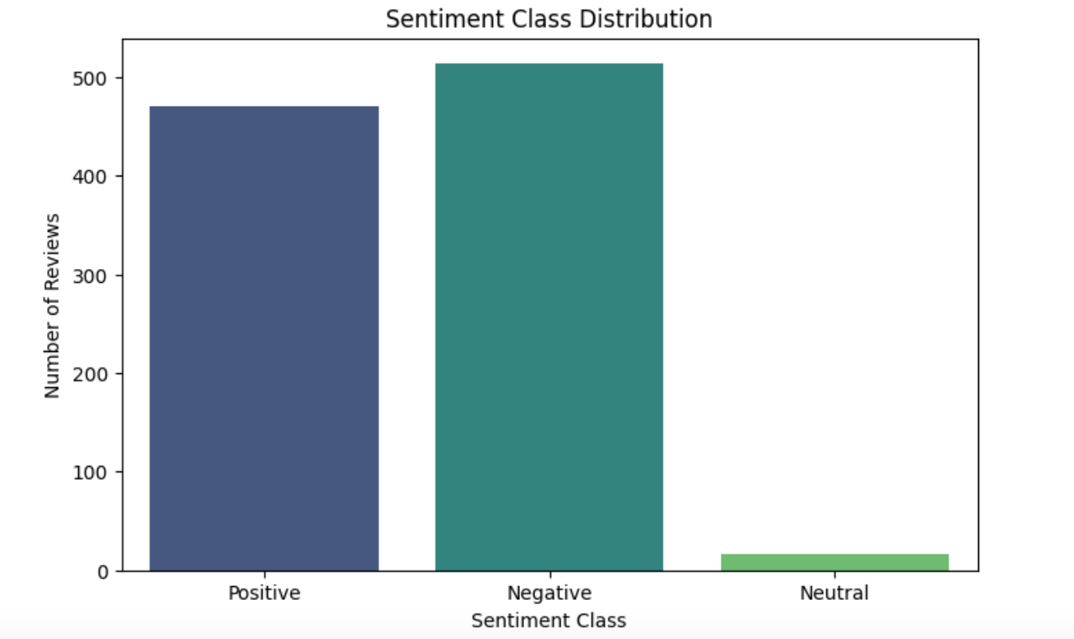
Sentiment Distribution
Distribution of Sentiment Classes
We have 1000 reviews and here is the distribution:
Positive Reviews: Approximately 470 reviews fall into the positive category.
Negative Reviews: Around 514 reviews fall into the negative category.
Neutral Reviews: Approximately 16 reviews fall into the neutral category.

Slide 4
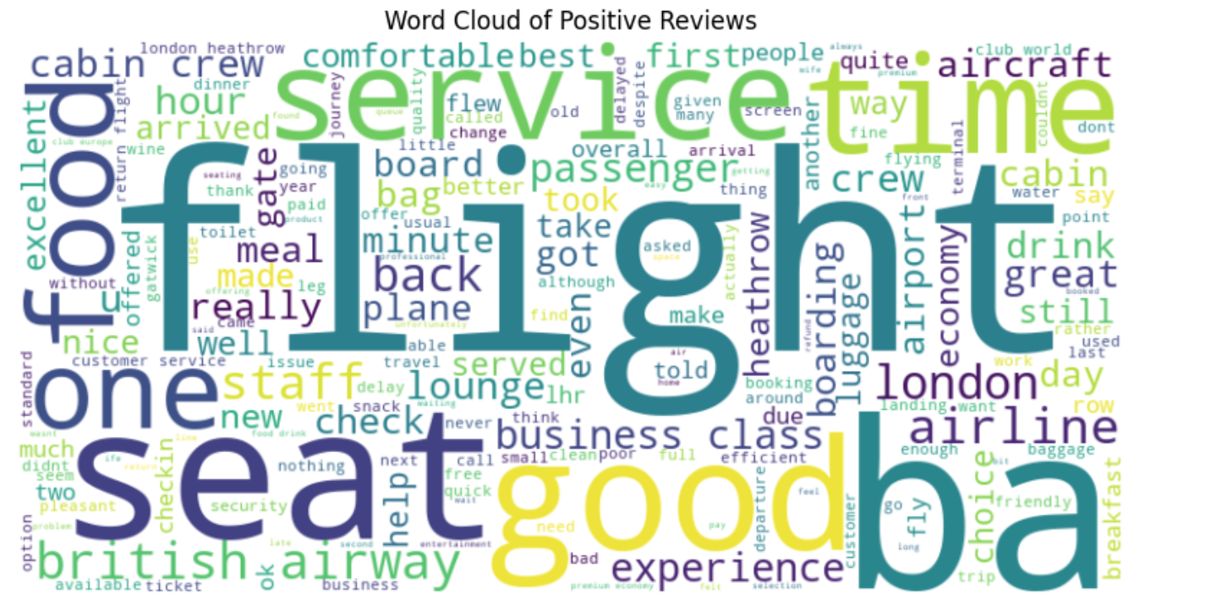
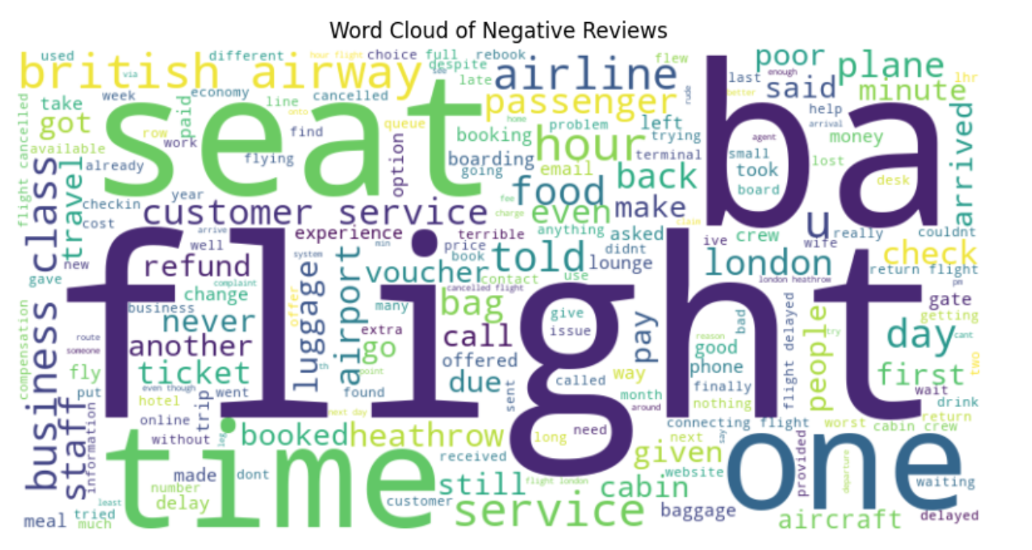
Word Clouds
Word Clouds of Positive and Negative Reviews
Strengths from positive reviews
“good”,“flight”,“service”,“seat”,“crew”,“food”,“comfortable”,“clean”. These words represent aspects that customers appreciate.
key areas of improvement from negative reviews
- Seat Comfort: Passengers mention discomfort related to seating arrangements.
Delays: Delays impact overall satisfaction.
- Customer Service: Negative experiences with customer service representatives.
Refunds: Issues related to refunds and vouchers.
- Business Class: Even premium services have notable criticisms.
- Baggage Handling: Problems with baggage handling and communication.
- Food: Dissatisfaction with in-flight meals.

Slide 5
Conclusion
Based on our analysis of positive reviews, customers frequently mention several strengths of British Airways. Key aspects that are highly appreciated include the quality of flights, excellent service, comfortable seating, friendly crew, good food options, and overall cleanliness. These factors contribute significantly to positive customer experiences and satisfaction.
Conclusion and Recommendations
While British Airways receives positive feedback in many areas, there are several key areas for improvement based on negative reviews. Customers have expressed concerns about seat comfort, delays impacting overall satisfaction, negative experiences with customer service representatives, issues related to refunds and vouchers, criticisms of premium services in Business Class, problems with baggage handling and communication, and dissatisfaction with in-flight meals. Addressing these areas is crucial to enhancing the overall passenger experience.
Recommendations
To improve the overall passenger experience, we recommend focusing on enhancing seat comfort, addressing delays and customer service issues, improving baggage handling and communication, and enhancing food options and quality in-flight. Additionally, reviewing and improving the refund and voucher process can help alleviate customer concerns and enhance satisfaction.

